Slide 1
Arrays and pointers – Pointer arithmetic and arrays, Memory allocation functions – static and dynamic memory allocation, array of pointers.

Slide 2
Pointer Applications
Objectives
❏ To understand the relationship between arrays and pointers
❏ To understand the design and concepts behind pointer arithmetic
❏ To write programs using arrays and pointer arithmetic
❏ To better understand the design behind passing arrays to functions
❏ To understand the C implementation of dynamic memory
❏ To write programs using static and dynamic memory allocation
❏ To understand and implement ragged arrays (arrays of pointers)

Slide 3
Arrays and Pointers
The name of an array is a pointer constant to the first element.
Because the array’s name is a pointer constant, its value cannot be changed.
Since the array name is a pointer constant to the first element, the address of the first element and the name of the array both represent the same location in memory.

Slide 4
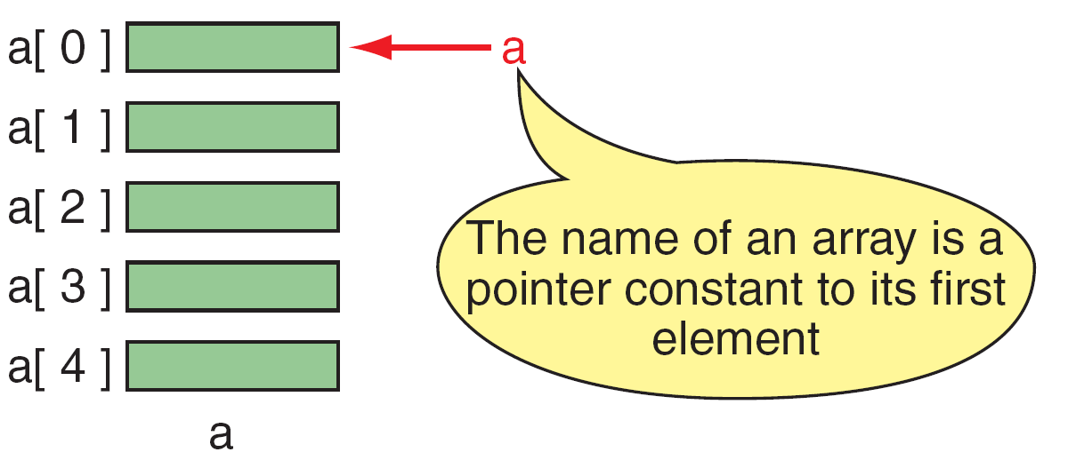
Pointers to Arrays

Slide 5
same
a &a[0]
a is a pointer only to the first element—not the whole array.
The name of an array is a pointer constant;
it cannot be used as an lvalue.
To access an array, any pointer to the first element can be used instead of the name of the array.

Slide 6
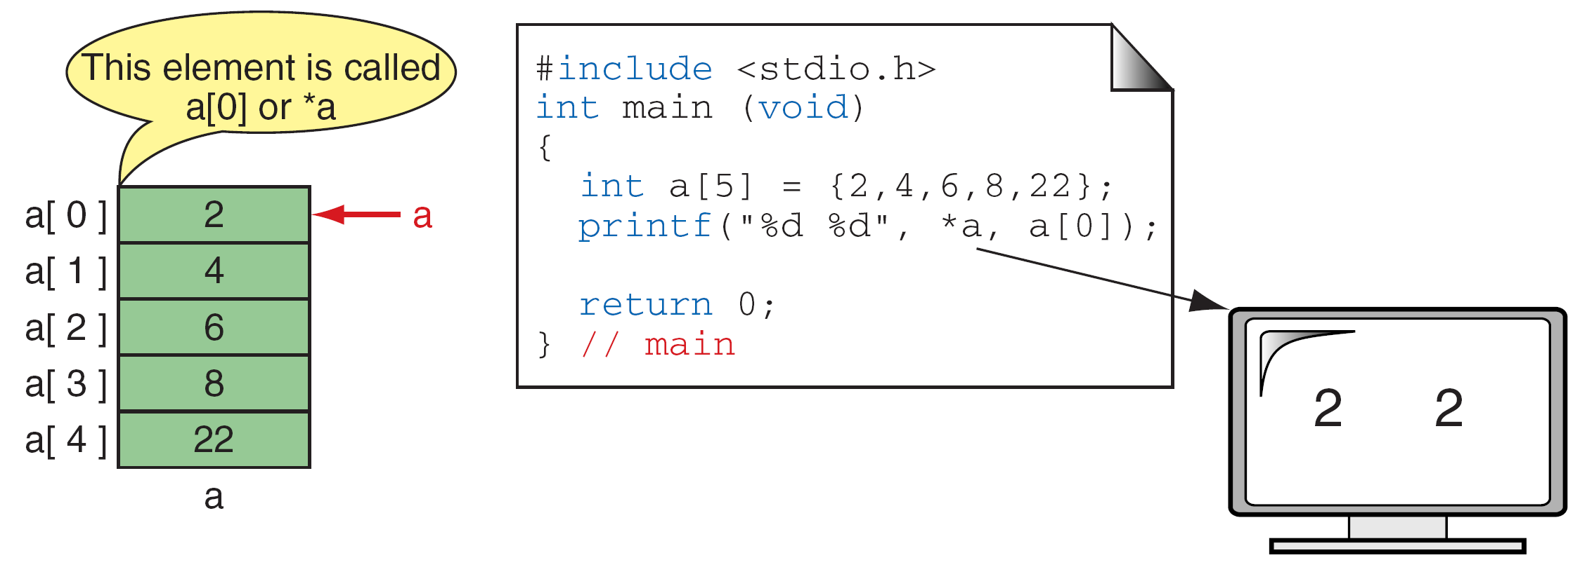
Dereference of Array Name

Slide 7
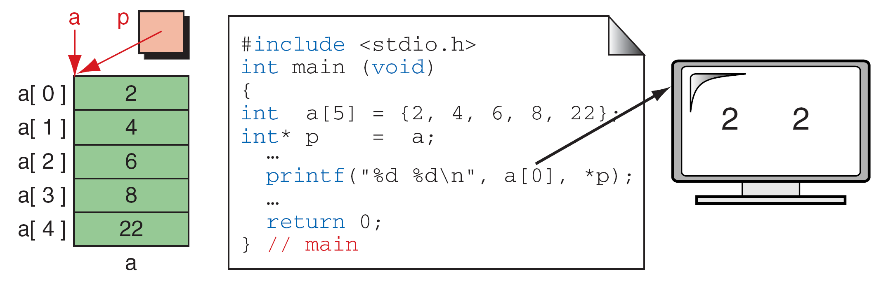
Array Names as Pointers

Slide 8
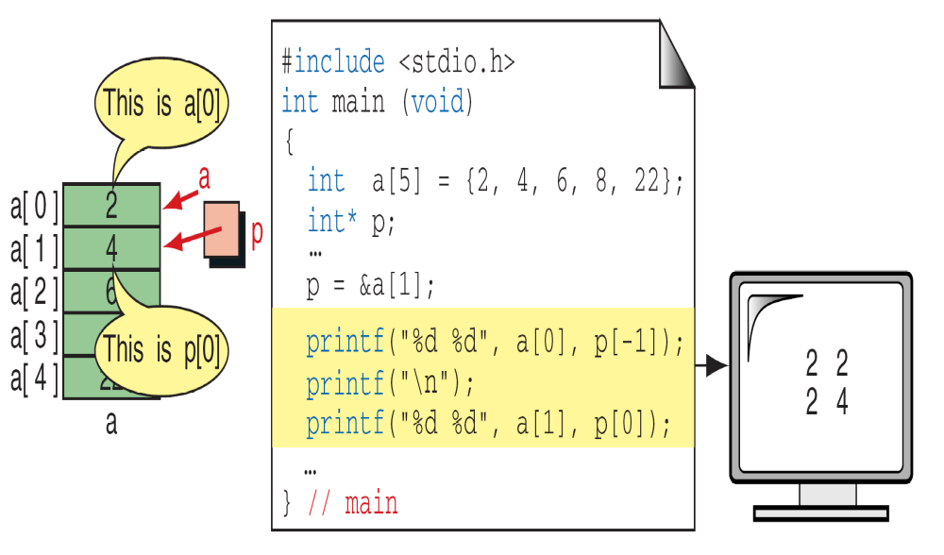
Multiple Array Pointers

Slide 9
Pointer Arithmetic and Arrays
Besides indexing, programmers use another powerful method of moving through an array: pointer arithmetic.
Pointer arithmetic offers a restricted set of arithmetic operators for manipulating the addresses in pointers.
Pointers and One-Dimensional Arrays
Arithmetic Operations on Pointers
Using Pointer Arithmetic
Pointers and Two-Dimensional Arrays

Slide 10
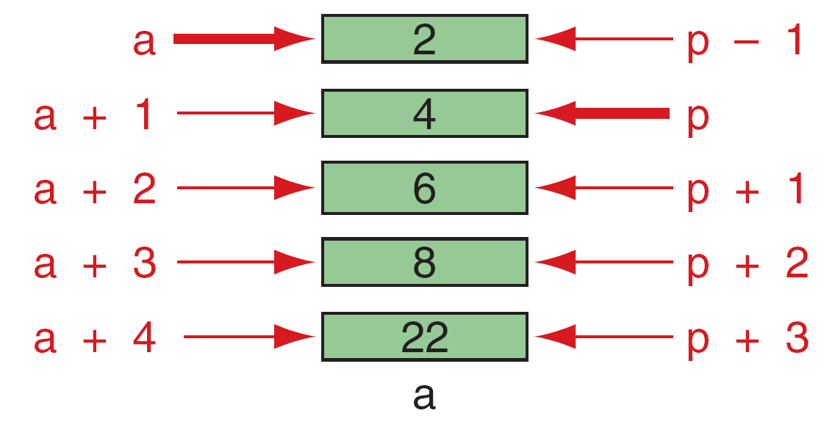
Given pointer, p, p ± n is a pointer to the
value n elements away.
Pointer Arithmetic

Slide 11
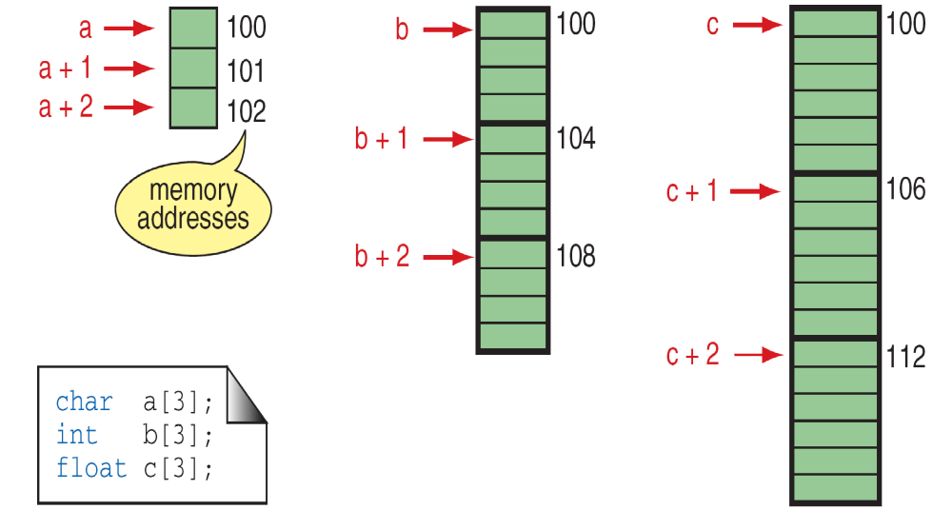
Pointer Arithmetic and Different Types

Slide 12
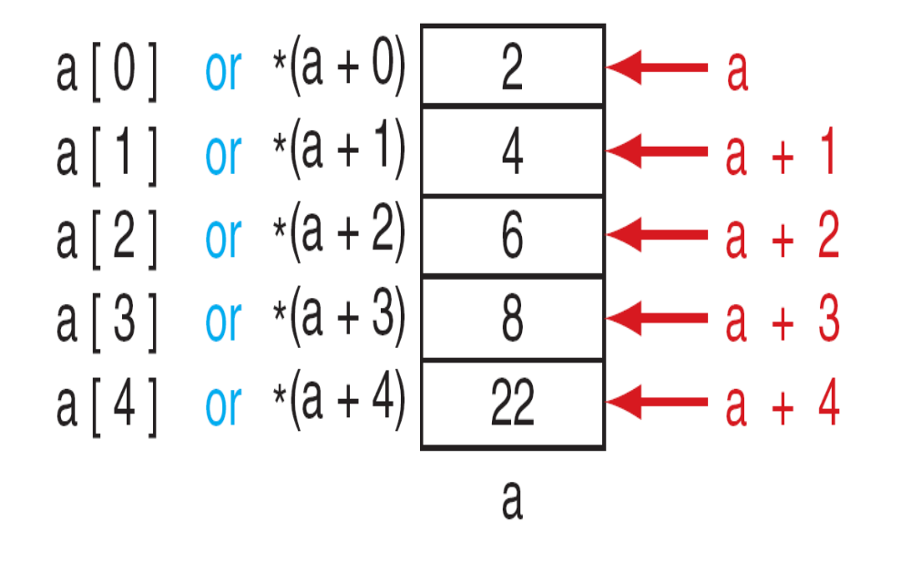
The following expressions are identical.
*(a + n) and a[n]
Dereferencing Array Pointers

Slide 13
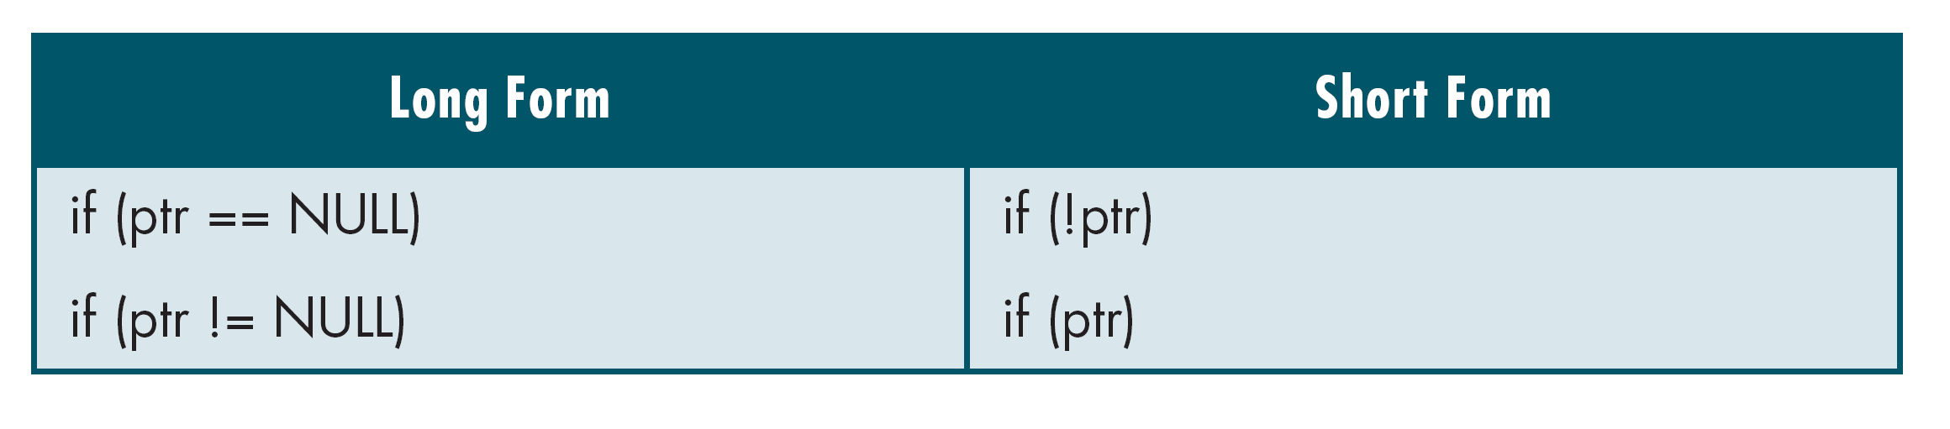
Some valid arithmetic operations on pointers:
p + 5
5 + p
p -5
p1 – p2
p ++
p --
Pointers and Relational Operators

Slide 14
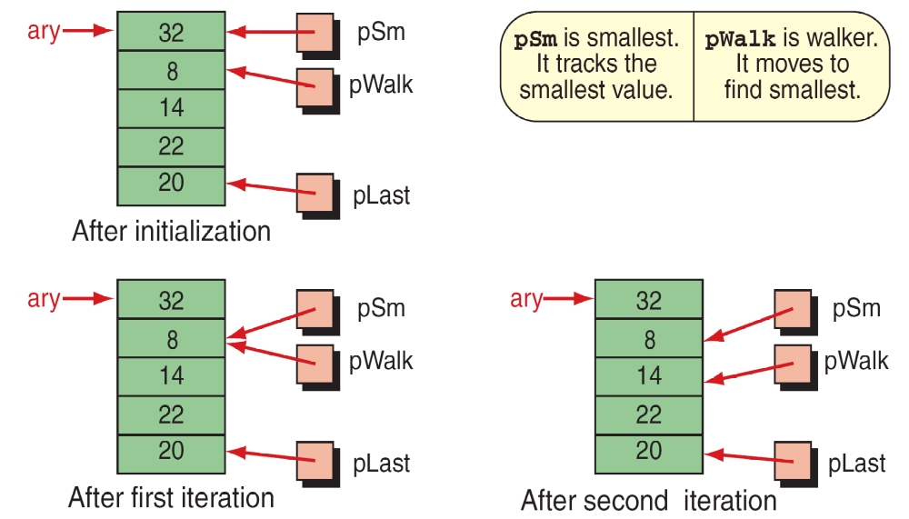
Find Smallest

Slide 15
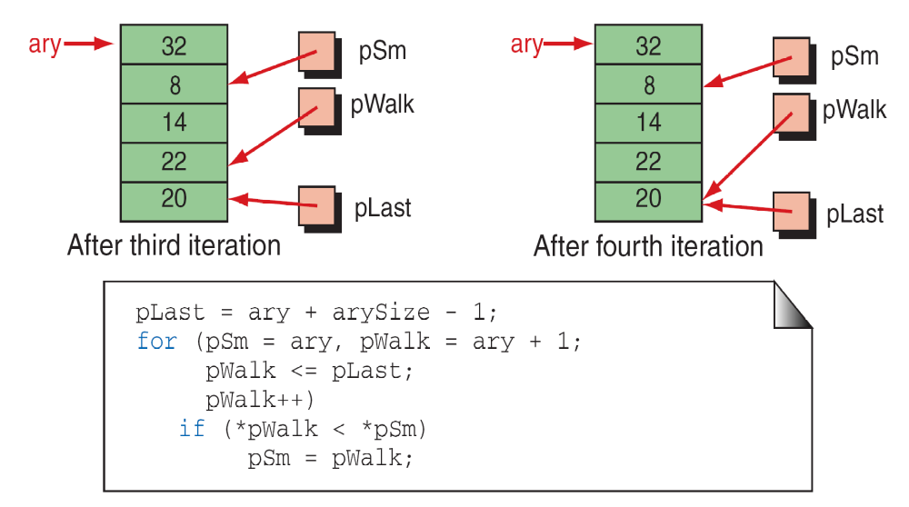
Find Smallest

Slide 16
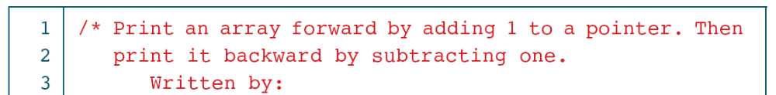
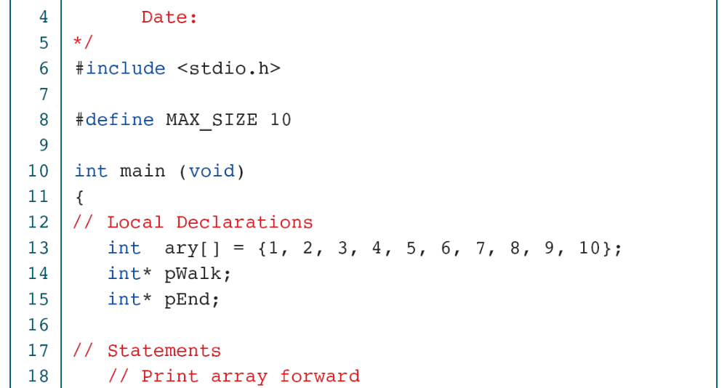
Print Array with Pointers

Slide 17
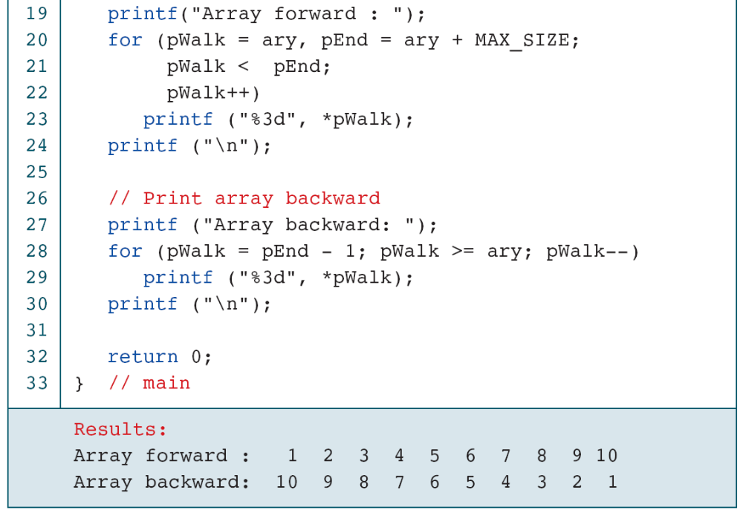
Print Array with Pointers

Slide 18
Pointers and two dimensional arrays:
Let us consider a two dimensional array A[i][j] then array elements can be accessed through pointer index notation using *(*(A + i) + j)
For example:
for(i =0; i < 3; i++)
{
for(j =0; j < 4; j++)
{
printf(“%d”, *(*(A + i) + j));
}
}
We recommend index notation for two-dimensional arrays.

Slide 19
Passing an Array to a Function
Now that we have discovered that the name of an array is actually a pointer to the first element, we can send the array name to a function for processing. When we pass the array, we do not use the address operator.
Remember, the array name is a pointer constant, so the name is already the address of the first element in the array.

Slide 20
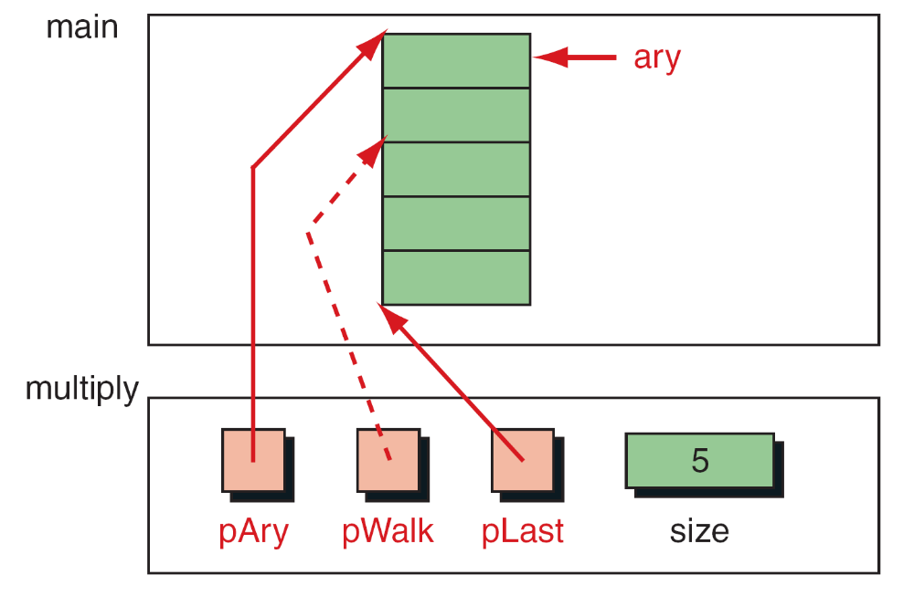
Variables for Multiply Array Elements By 2

Slide 21
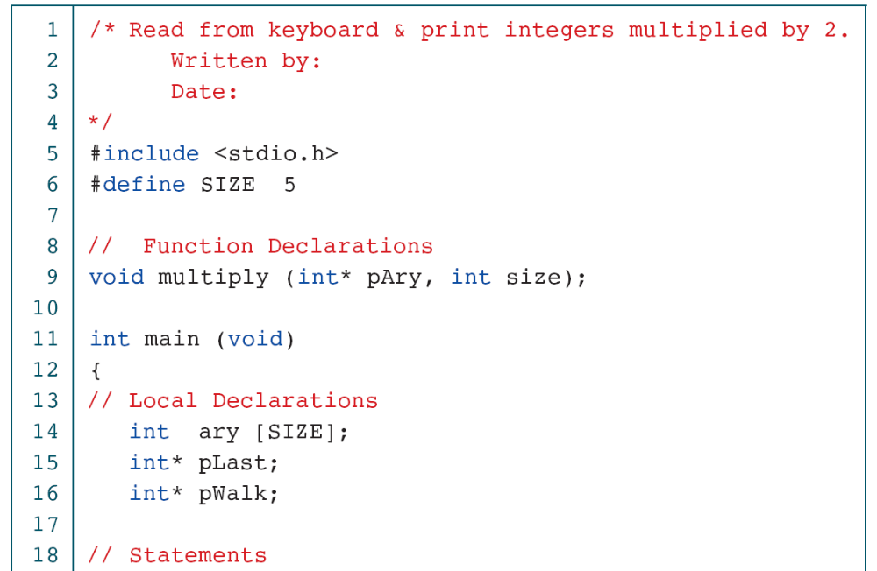
Multiply Array Elements by 2

Slide 22
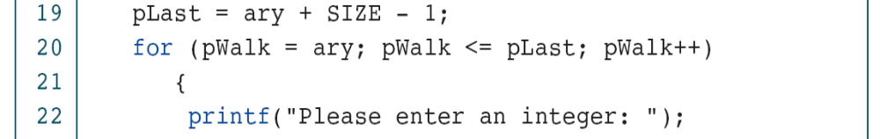
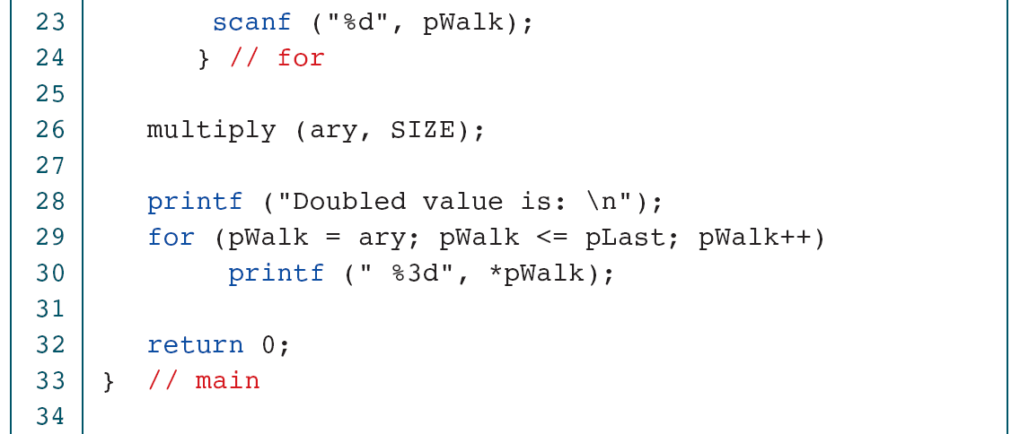
Multiply Array Elements by 2

Slide 23
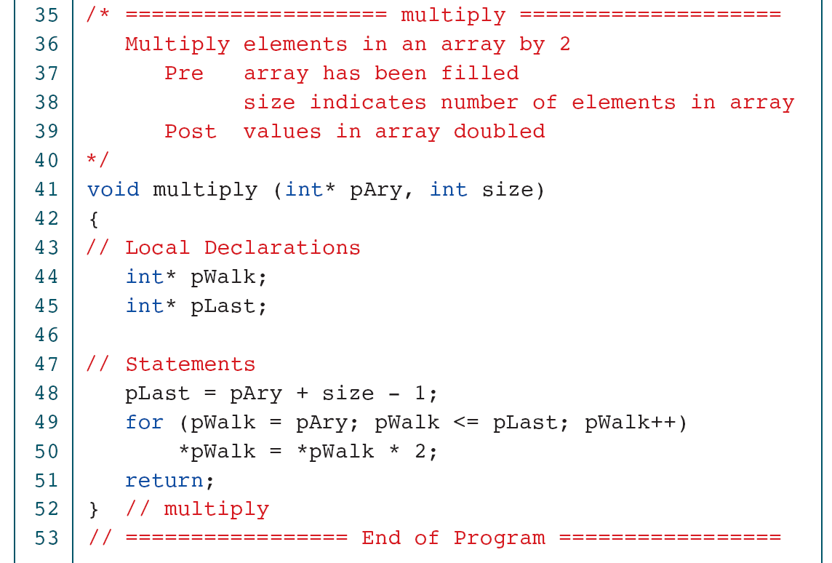
Multiply Array Elements by 2

Slide 24
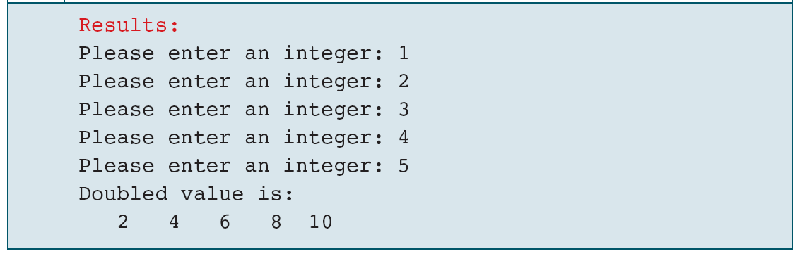
Multiply Array Elements by 2

